Slide 1

Python Level 2
882.33
Lesson 3: Getting Classy

Slide 2
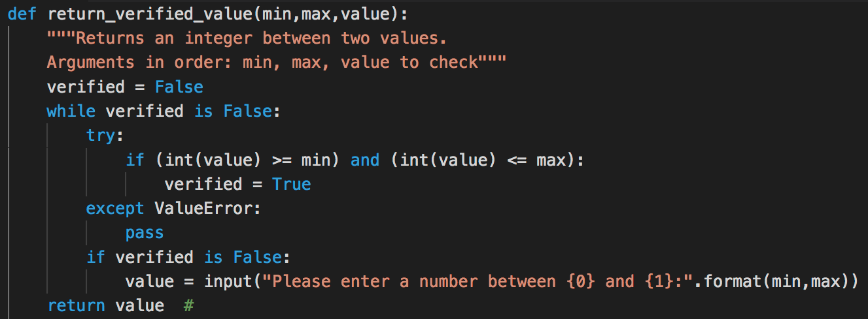

Previously…
My completed exercise for last week: http://eca-python/l2s2soluction

Slide 3
What is a Restaurant?
What properties does a Restaurant have?

Slide 4
What is a Restaurant?
What properties does a Restaurant have?
How much we like it
How far away it is
What sort of food it sells
How expensive it is
Anything else?

Slide 5
What is a Restaurant?
What properties does a Restaurant have?
How much we like it
How far away it is
What sort of food it sells
How expensive it is
Anything else?
It might be a takeaway
It might have a dress code

Slide 6
http://s2.quickmeme.com/img/72/72ba90745628a5c27e7f844dacdafc9318cf7876b9de9f424cebf0018345e1cc.jpg

Slide 7
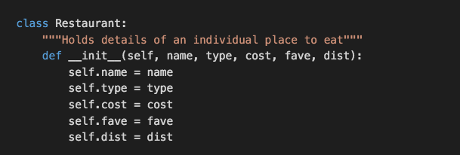
What does this do?
When we start a class, much like a program, we might want to do a few things
What do you think is the meaning of self ?
Put this class in a new file (for now) so we can experiment with it.

Slide 8

Let’s Get Classy
What will this do?

Slide 9
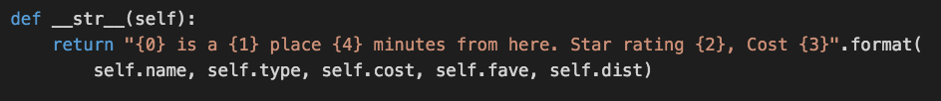

What happened?
When you print, Python tries to render the output as a string
Python doesn’t know how to turn a Restaurant object into a string
Another member method for the Restaurant class:
Does print moro work now?

Slide 10
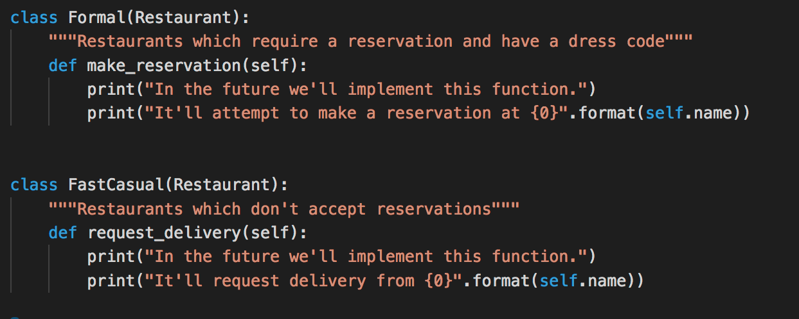
Being more specific

Slide 11
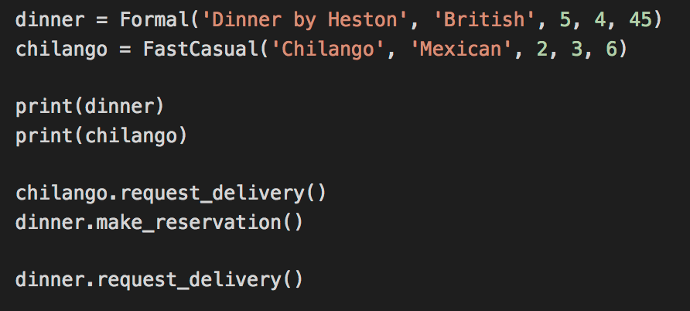
Getting your inheritance

Slide 12
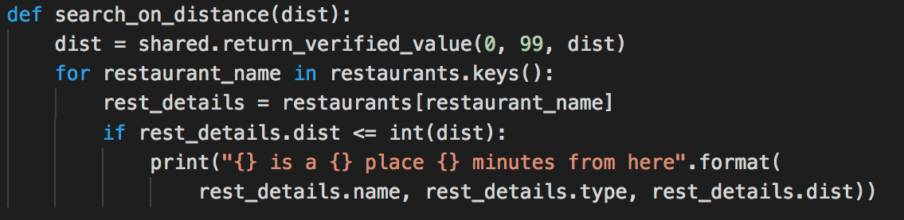
Exercise / Homework…
Start with the following code: http://eca-python/l2session3
Update the rest of your program (load, save, search) to use an instance of Restaurant instead of a dictionary
Example:

